Slide 1
Indexes
Relationships and more

Slide 2
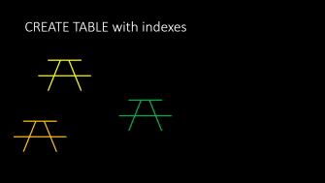


In this video...

Slide 3

What are indexes?

Slide 4
What are indexes?
Indexes provide the following:
Faster lookup speed
Uniqueness
They define relationships
Primary keys
Foreign keys

Slide 5
Faster lookups
Adding an index will speed up lookups but slow down inserts
Indexes may allow duplicates
CREATE TABLE syntax
These allow duplicates
INDEX (name)
INDEX (color, style)
KEY (name)
KEY (color, style)

Slide 6
Unique indexes
Indexes can require uniqueness on one or more columns
A duplicate value across all columns of a unique index is an error
A unique index is like a Java Set
CREATE TABLE syntax
UNIQUE KEY (name)
UNIQUE KEY (color, style)
UNIQUE INDEX (license_no)
UNIQUE (size)

Slide 7
Compound unique index
A compound index is indexed on more than one column
CREATE TABLE recipe_category (
FOREIGN KEY (recipe_id) ...
FOREIGN KEY (category_id) ...
UNIQUE KEY (recipe_id, category_id)
);
The unique key means that only one category of each type can be set for any given recipe
You can have a Vegan category and a Mexican category but not 2 Vegan categories

Slide 8
Relationships defined
A primary key in one table is referenced by a foreign key in another table
Two rows are related if the primary key value and foreign key value are the same
Primary keys are normally INTs

Slide 9



CREATE TABLE with indexes

Slide 10
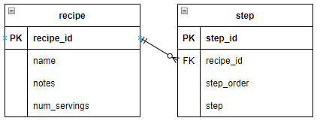
Relationship CREATE TABLE syntax
Recipe table
recipe_id INT AUTO_INCREMENT NOT NULL,
PRIMARY KEY (recipe_id)
Step table
step_id INT AUTO_INCREMENT NOT NULL,
recipe_id INT,
PRIMARY KEY (step_id),
FOREIGN KEY (recipe_id)
REFERENCES recipe (recipe_id)

Slide 11
Compound primary key
It is possible to declare a compound primary key using more than one column
If the table is referenced by another table (foreign key) it is best to use an auto-increment integer primary key
Otherwise, it's hard(er) to keep the key values aligned on related tables
ORM tools (Hibernate or EclipseLink) may require integer primary key fields on all tables

Slide 12
Many-to-many relationships
Requires a join table
Recipes and categories have a many-to-many relationship
A recipe can have many categories
A category can have many recipes
The join table name is the name of the primary key tables separated by an underscore
The name of the recipe and category join table is recipe_category

Slide 13
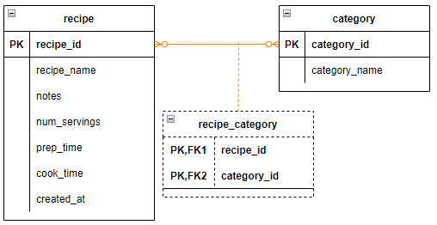
Many-to-many diagram

Slide 14
Many-to-many CREATE TABLE statement
CREATE TABLE recipe (
recipe_id INT AUTO_INCREMENT NOT NULL,
PRIMARY KEY (recipe_id)
);
CREATE TABLE category (
category_id INT AUTO_INCREMENT NOT NULL,
PRIMARY KEY (category_id)
);
CREATE TABLE recipe_category (
recipe_id INT,
category_id INT,
FOREIGN KEY (recipe_id) REFERENCES recipe (recipe_id),
FOREIGN KEY (category_id) REFEREICES category (category_id),
UNIQUE KEY (recipe_id, category_id)
);

Slide 15
Deleting child rows
When a parent row (recipe) is deleted, child rows (step, ingredient, recipe_category) also need to be deleted
Otherwise, the child rows will be orphaned with the foreign key referencing a value that does not exist in the parent
MySQL will automatically delete the child rows when ON DELETE CASCADE is added to the FOREIGN KEY constraint

Slide 16
ON DELETE CASCADE syntax
The corresponding step rows are deleted when the recipe row is deleted
CREATE TABLE recipe (
recipe_id INT AUTO_INCREMENT NOT NULL,
PRIMARY KEY (recipe_id)
);
CREATE TABLE step (
step_id INT AUTO_INCREMENT NOT NULL,
recipe_id INT,
PRIMARY KEY (step_id),
FOREIGN KEY (recipe_id)
REFERENCES recipe (recipe_id)
ON DELETE CASCADE
);

Slide 17

Building the project

Slide 18
Building the project...
Video project:
Add the INDEX statements to the schema definition
Add the JOIN table to the schema for the many-to-many relationship between recipe and category

